Slide 1




K. J. Somaiya College of Engineering, Mumbai
MINI PROJECT PRESENTATION
ON
Data Preprocessing Application/UI for NLP Tasks
Name : Faustina Lazarus [Roll No – 16034423008]
M.TECH MINI PROJECT
Mentor : PROF. ASHWINI DALVI
MTECH PROGRAM IN “AI&DS”
Academic Year 2023-24

Slide 2
Outline of the Presentation
Introduction
Problem Definition
Objectives
Literature review
Block Diagram
Methodology
Results/Discussion
Conclusion
Future Scope
References

Slide 3

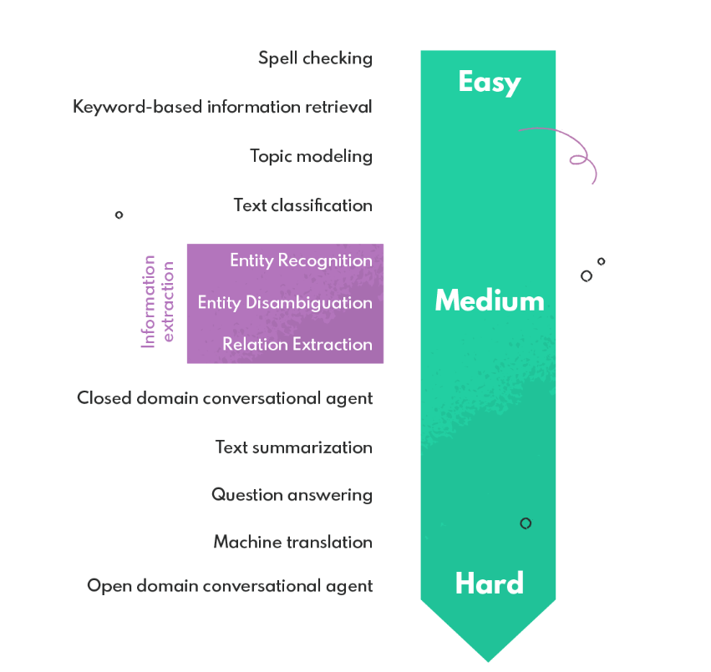
Introduction
NLP Tasks:
Figure 1: Image Courtesy-https://nexocode.com/blog/posts/definitive-guide-to-nlp/

Slide 4
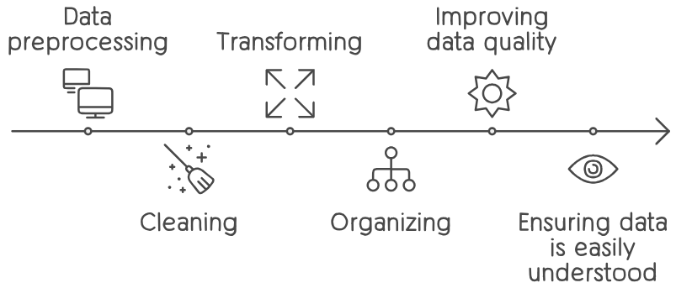
Introduction
Data preprocessing prepares raw data for analysis and modeling.
Raw data often contains inconsistencies, errors and irrelevant information. Using it directly can lead to unreliable and inaccurate results.
It’s a crucial step in NLP as it helps to clean and organize text data, making it more suitable for NLP tasks
Preprocessing significantly improves the performance and results of NLP models.

Slide 5
Problem Definition
Data preprocessing is a tedious task of repetitive, inconsequential code and it is filled with a number of issues.
Manual preprocessing faces issues like:
Time-consuming to write numerous lines of code.
Error-prone.
Complex to write and understand the logic behind the code.
The goal of this project is to create a simple user interface which can automate repetitive tasks, while ensuring consistency and efficiency in NLP data preprocessing.

Slide 6
Objectives
To implement python libraries for consolidated NLP tasks and develop UI for data preprocessing NLP tasks.
To do that:
Conducting research to comprehend NLP tasks.
Consolidating NLP tasks for confirming scope of data pre-processing.
Implementing python libraries for consolidated NLP tasks.
Develop UI for data pre-processing NLP tasks.

Slide 7
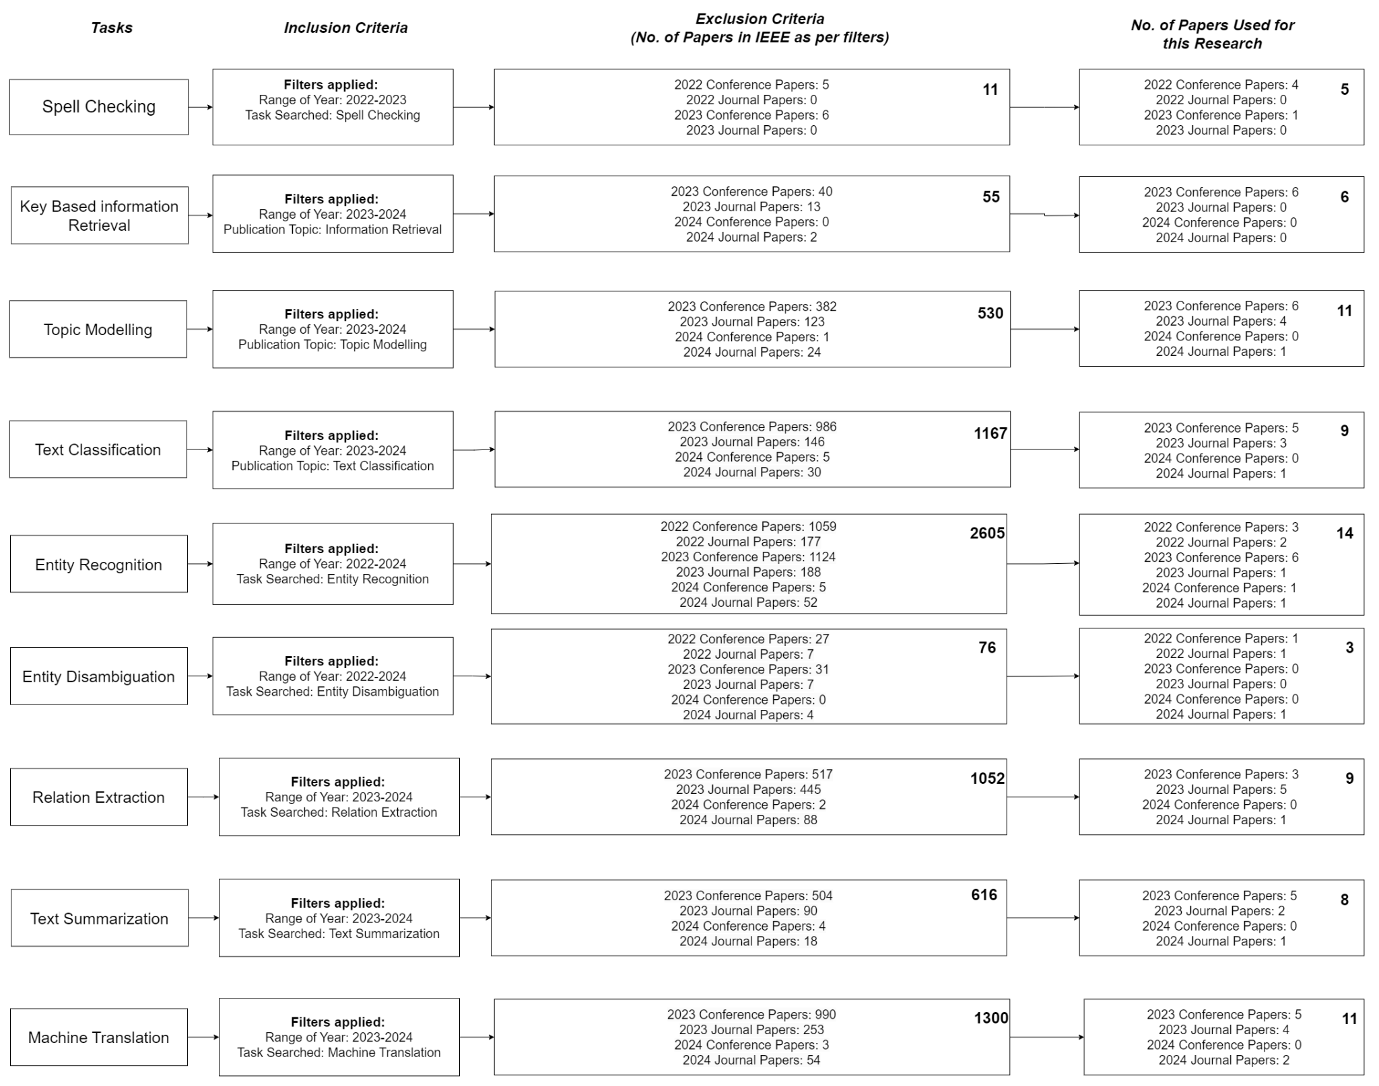
Literature Review
Figure 2: Literature Survey
76 Total

Slide 8
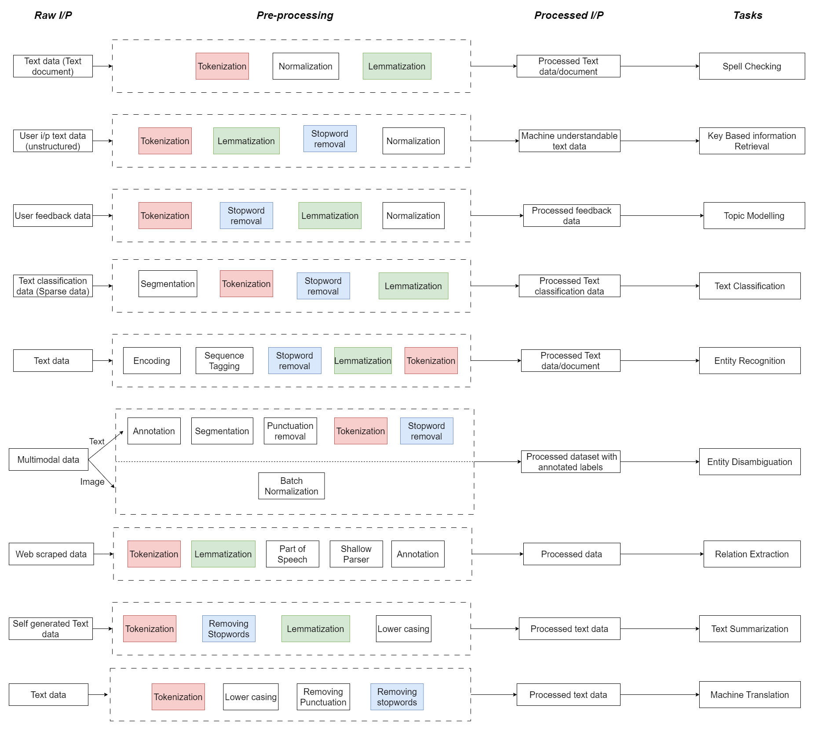
Literature Review
Tokenization,Lemmatization and Stopword removal.
As seen in the diagram, Tokenization is repeated 9 times, Stopword removal is repeated 7 times and Lemmatization is repeated 7 times.
Figure 3: Literature Survey Pre-processing
Our proposed solution integrates tokenization, stopwords removal and lemmatization.

Slide 9
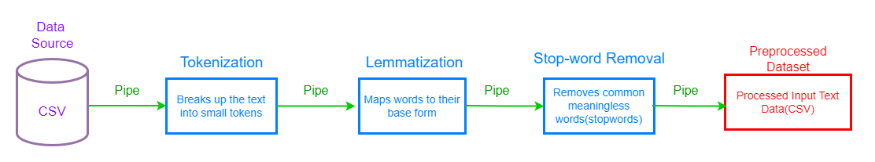
Block Diagram
Figure 4: Block Diagram (Pipe and Filter Architecture)

Slide 10
Methodology
Dataset:
WikiQA Corpus
The WikiQA corpus is a new publicly available set of question and sentence pairs, collected and annotated for research on open-domain question answering.
Size: 7 columns and 29,291 rows.
Source: https://www.microsoft.com/en-us/download/details.aspx?id=52419
For testing purposes, changes were made to the number of rows and reduced to 100 rows.

Slide 11
Methodology
Dataset:
2. IMDB Dataset
The IMDb dataset consists of movie reviews along with their corresponding sentiment labels, usually classified as positive or negative sentiments.
Size: 2 columns and 50,000 rows.
Source: https://www.kaggle.com/datasets/lakshmi25npathi/imdb-dataset-of-50k-movie-reviews
For testing purposes, changes were made to the number of rows and reduced to 500 rows.

Slide 12
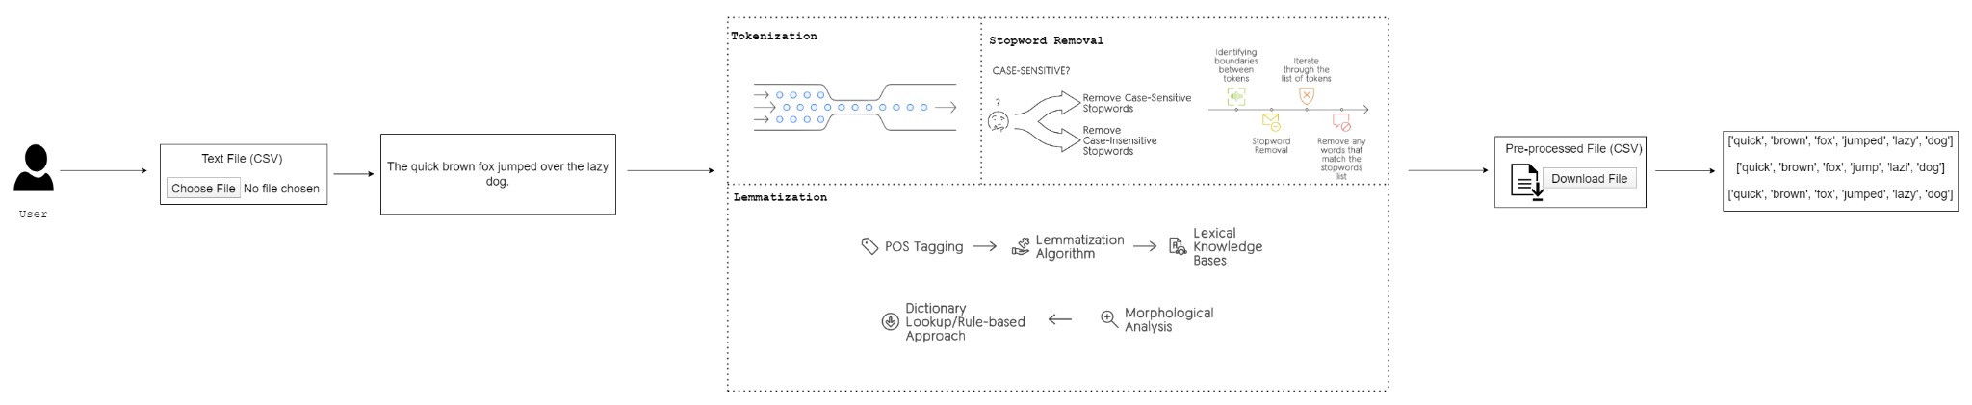
Methodology
Algorithms:
Figure 5: Conceptual Diagram

Slide 13
Methodology
Libraries:
spaCy: A library for advanced natural language processing in Python, utilized for tokenization and lemmatization of text data.
NLTK (Natural Language Toolkit): A leading platform for building Python programs to work with human language data, employed for tasks like stopwords removal and other text preprocessing tasks.
Tablib: A Python library for handling tabular data, particularly CSV files, which is essential for data manipulation and processing.
Import-Export: A Django package that simplifies importing and exporting data in various formats, making it easier to manage data within the application.

Slide 14

Methodology
Framework:
Model Layer: Defines data structure with Sample and PreprocessedSample models.
View Layer: Handles user requests with views like upload, run_tasks, preview, and download_preprocessed_dataset.
Template Layer: Renders HTML dynamically using templates for user interfaces.
URL Dispatcher: Maps URLs to views for routing requests.
Admin Interface: Provides built-in admin interface for managing data.

Slide 15
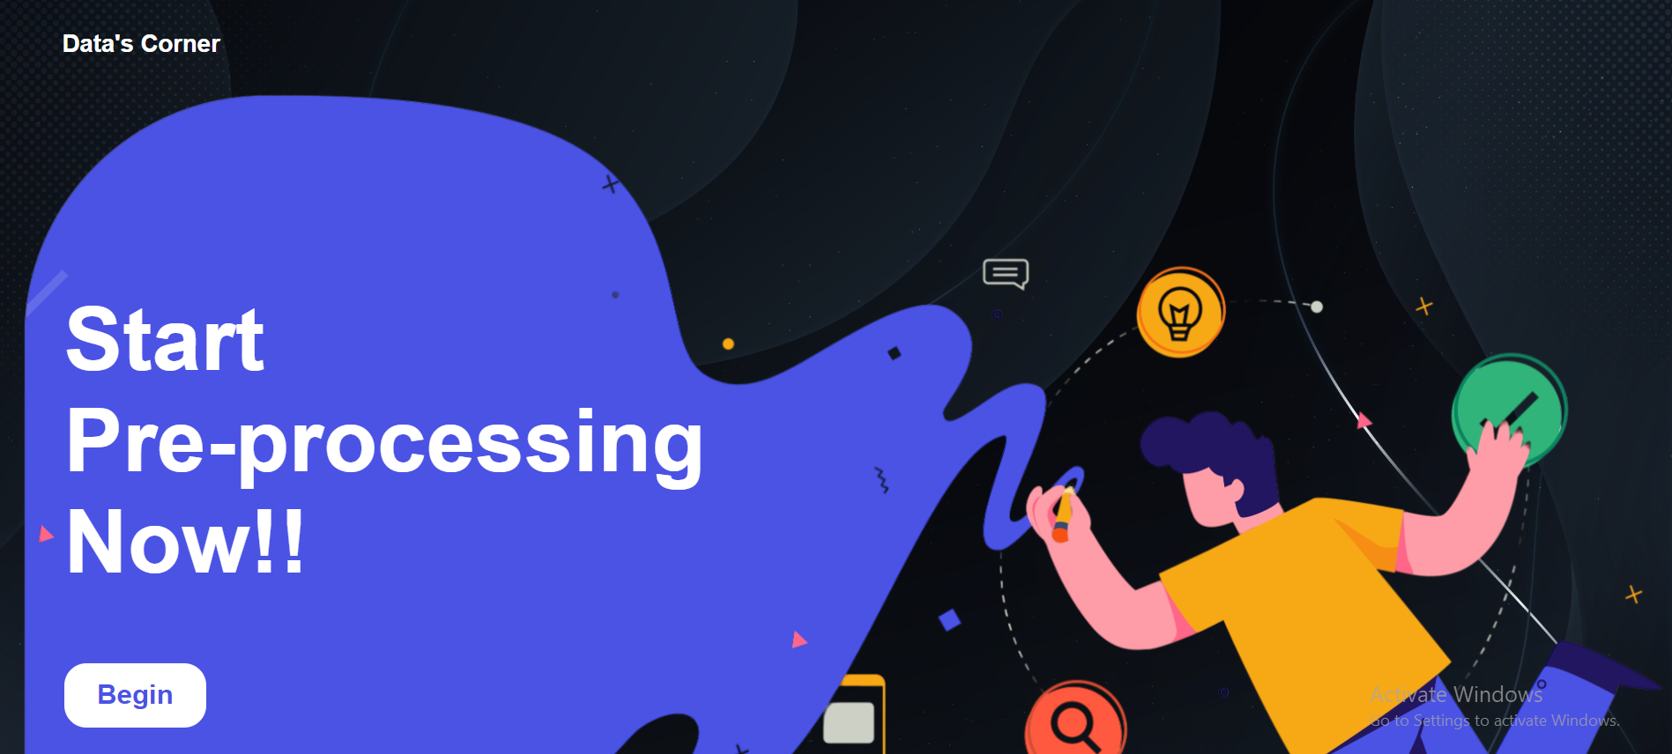
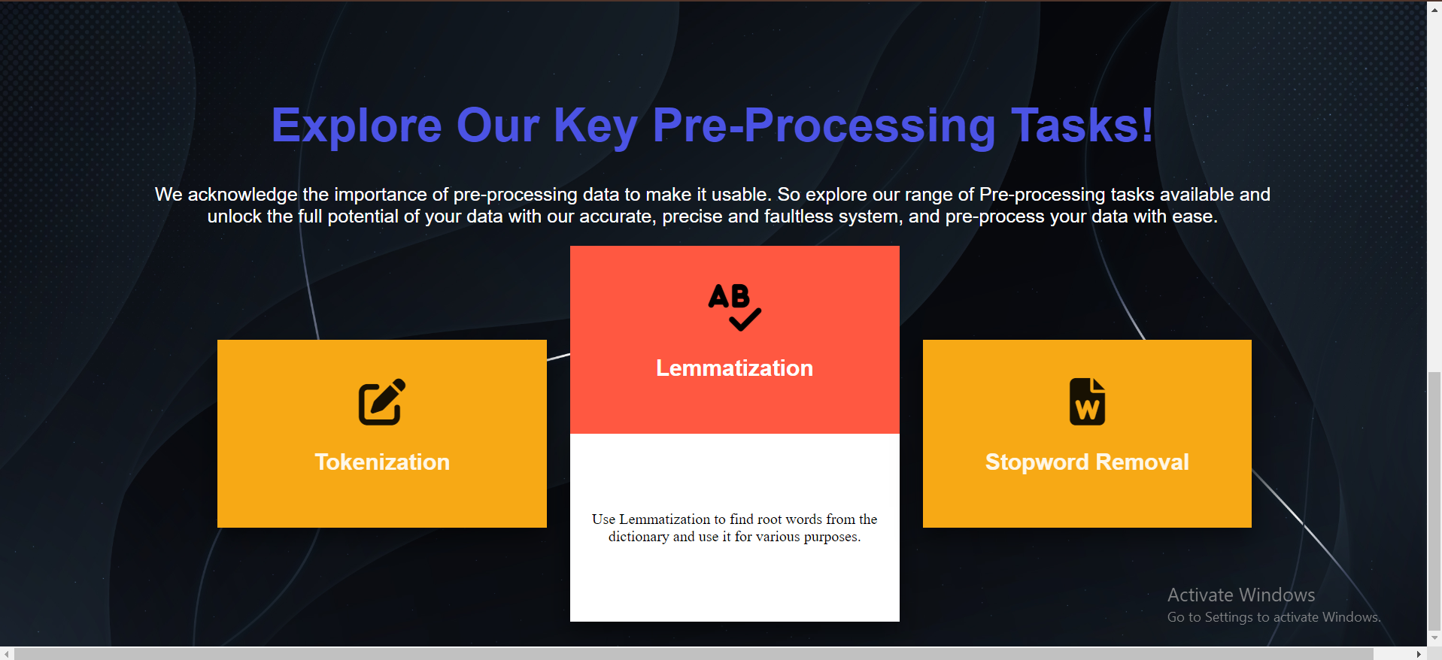
Results/Discussions
Figure 6: Home Page
Figure 7: Home Page

Slide 16
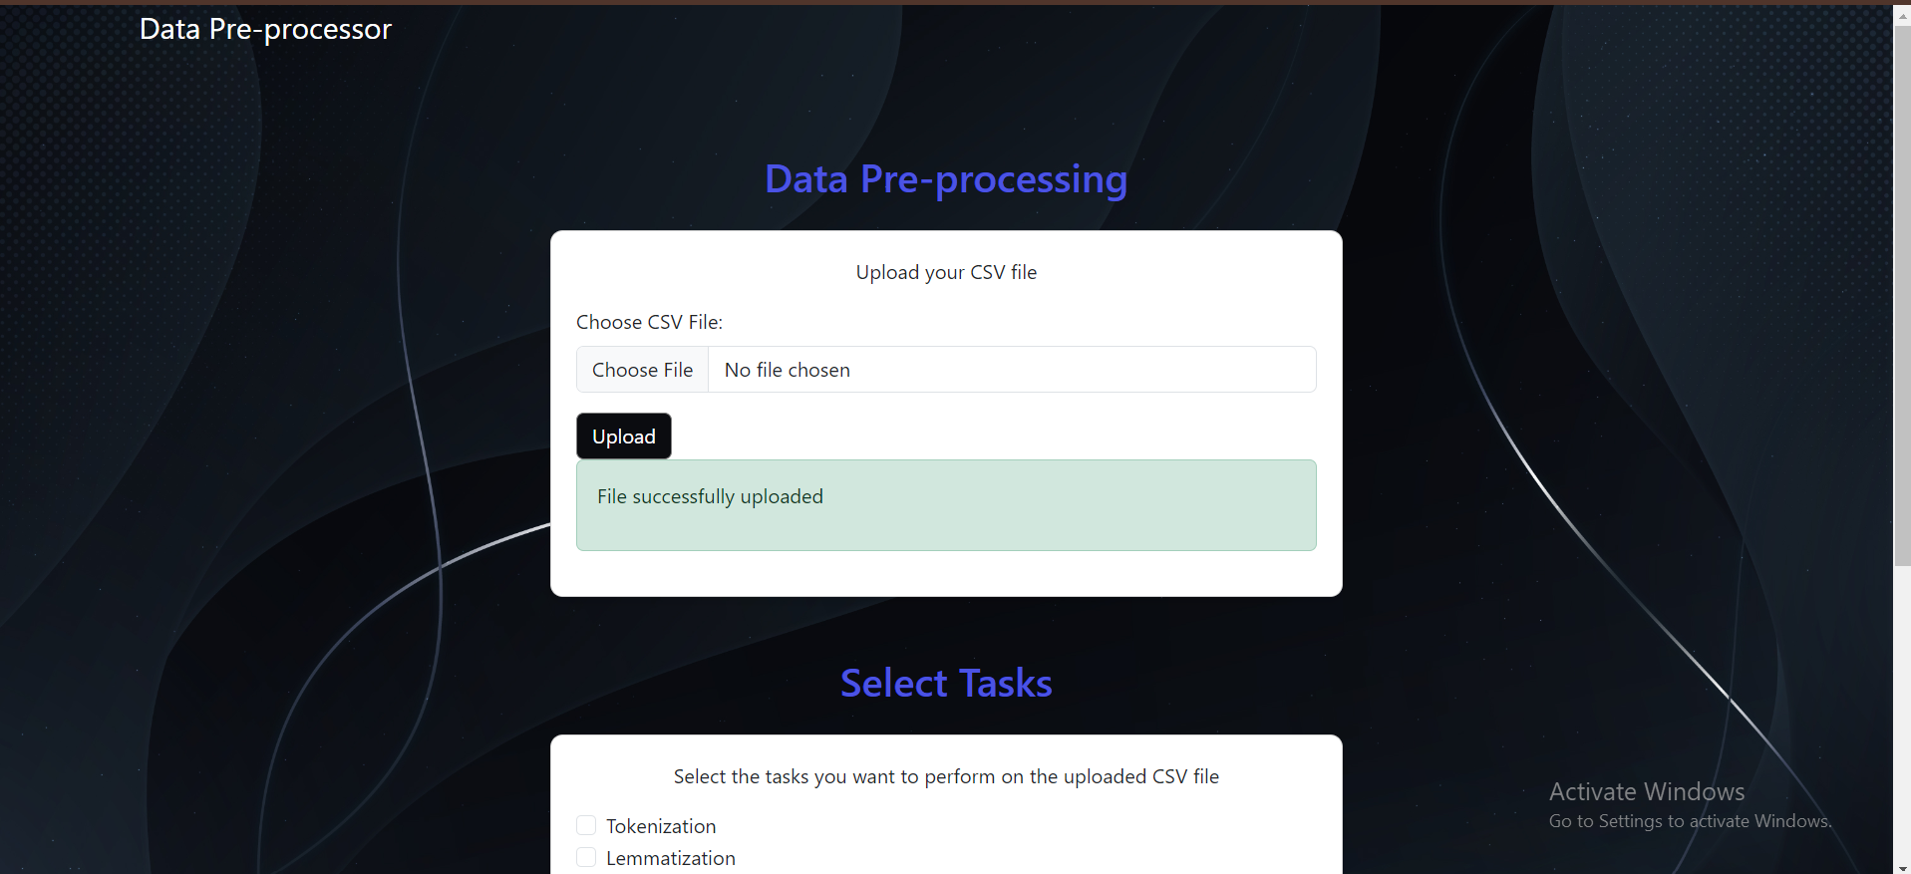
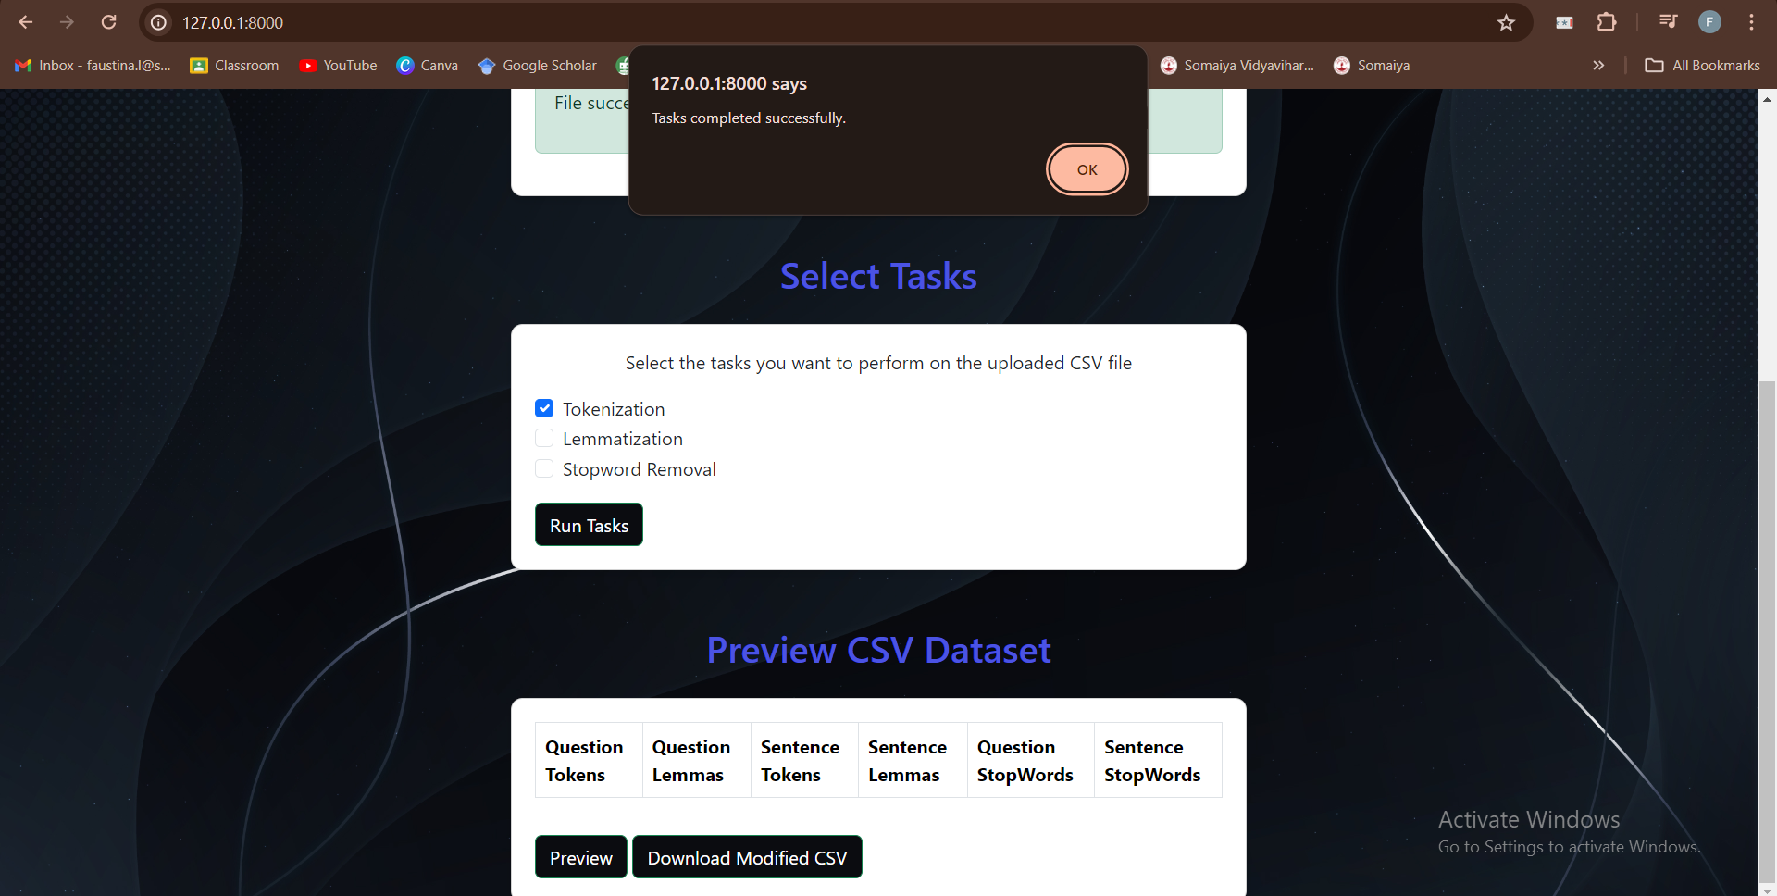
Results/Discussions
Figure 8: Data Pre-processor Page
Figure 9: Data Pre-processor Page- Tasks Section

Slide 17
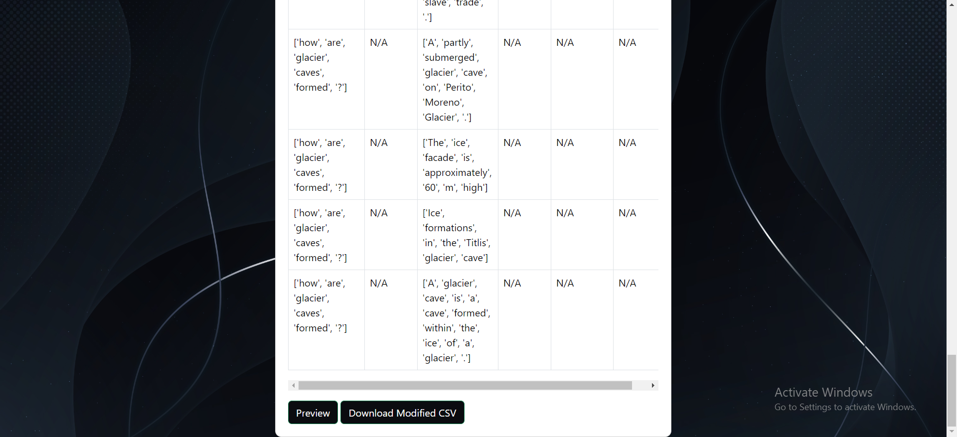
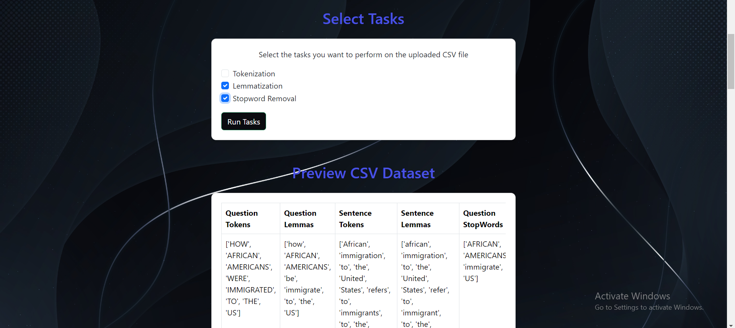
Results/Discussions
Figure 10: Data Pre-processor Page- Preview Section
Figure 11: Data Pre-processor Page- Tasks Section

Slide 18
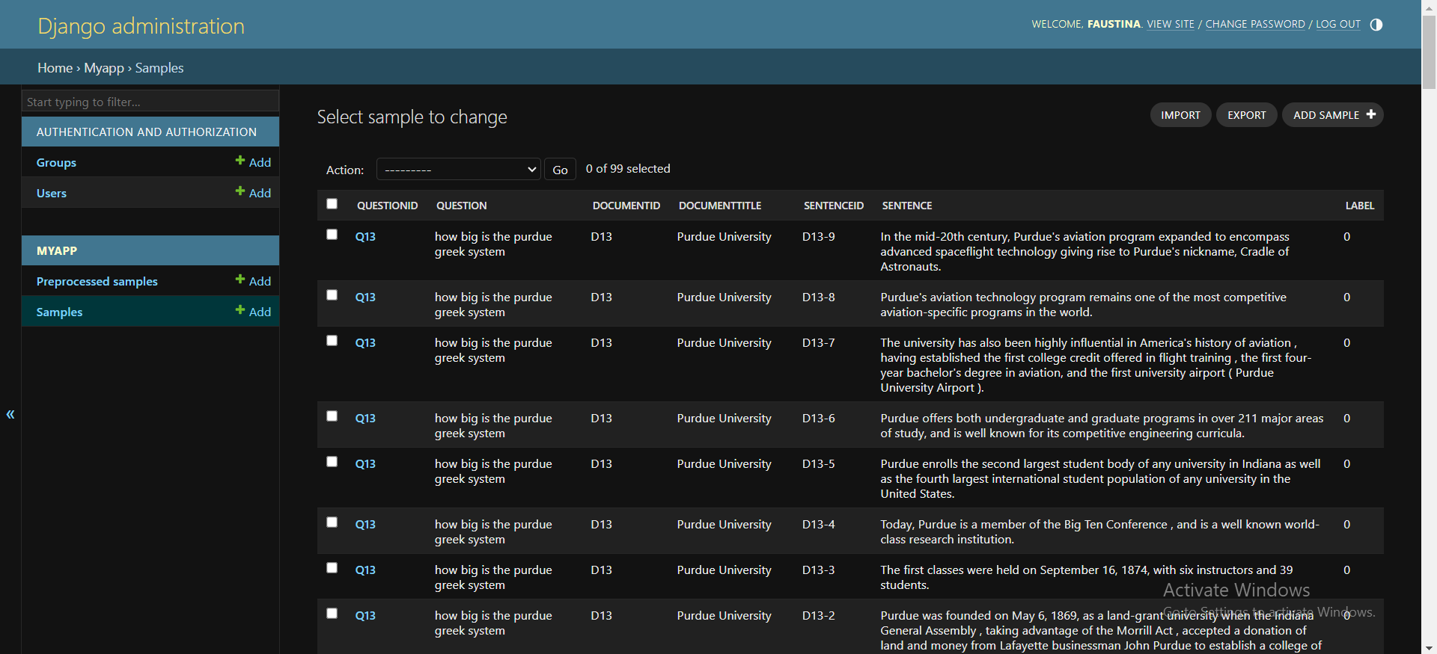
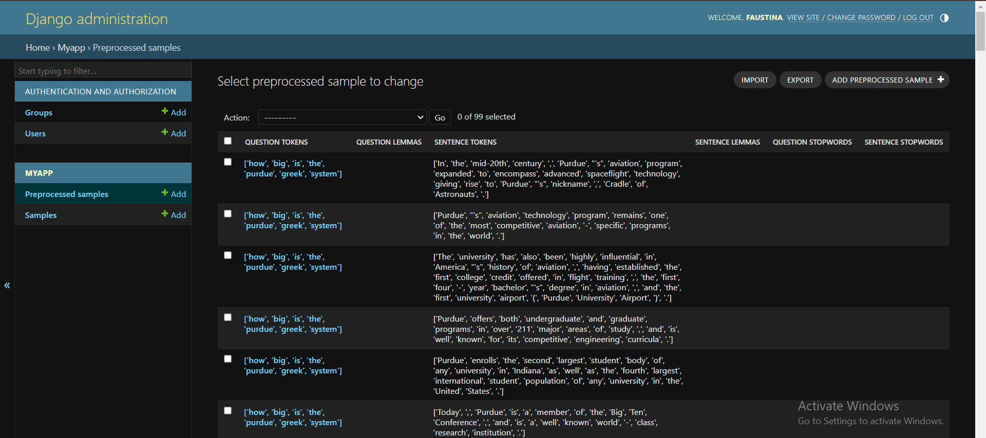
Results/Discussions
Figure 12: Admin Page
Figure 13: Admin Page

Slide 19
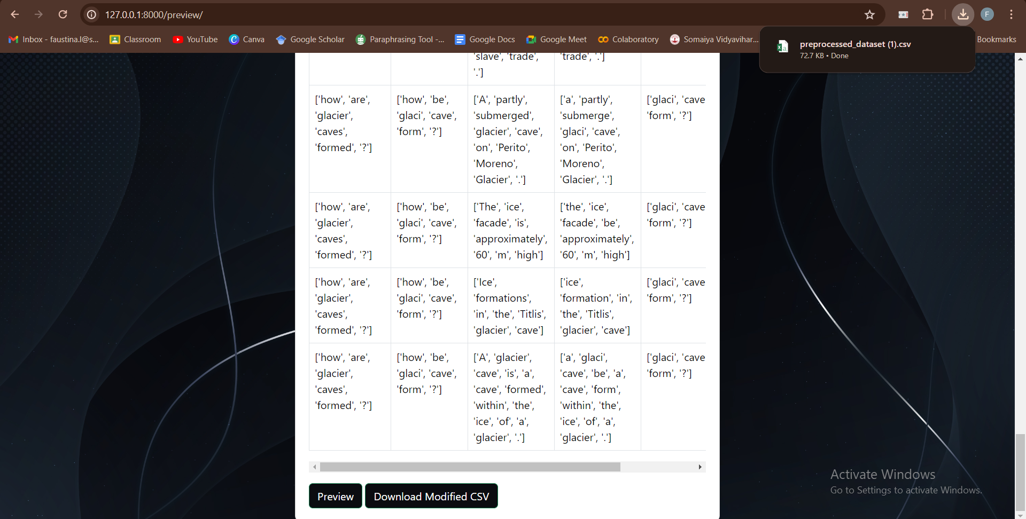
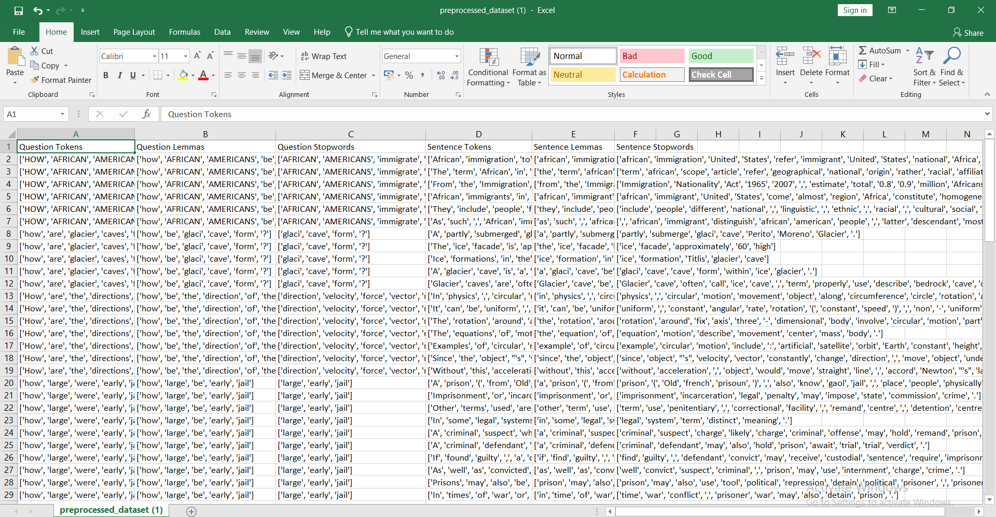
Results/Discussions
Figure 14: Data Pre-processor Page- Preview and Download Section
Figure 15: Pre-processed CSV File

Slide 20
Conclusion
In conclusion, a well-designed data preprocessing application/UI has been developed for successful NLP tasks. It allows for efficient and accurate cleaning, formatting, and organizing of data, which is essential for the performance of NLP algorithms. A user-friendly interface with intuitive features and options can greatly improve the user experience and make the data preprocessing process more manageable. It is an essential tool for any NLP practitioner and can greatly impact the success of their work.

Slide 21
Future Scope
The future scope for enhancing the data preprocessing application includes extending its support for multiple data formats beyond CSV. By accommodating formats such as JSON, XML, Excel, and other formats commonly used in data analytics and machine learning, the application will become more versatile and applicable to a wider range of datasets. Additionally, there is a need to develop capabilities for real-time data preprocessing. This involves enabling continuous processing of incoming data streams, ensuring immediate availability of preprocessed data for analysis or model training. Furthermore, there is potential in enabling collaborative data preprocessing by supporting multi-user access, version control, and sharing of preprocessing configurations and results.

Slide 22
REFERENCES
[1] J. Fior et al., "Legal Entity Disambiguation for Financial Crime Detection," 2022 IEEE International Conference on Big Data (Big Data), Osaka, Japan, 2022, pp. 6639-6641, doi: 10.1109/BigData55660.2022.10020700.
[2] D. Luo, S. Ma, Y. Yan, C. Hu, X. Zhang and J. Huai, "A Collective Approach to Scholar Name Disambiguation," in IEEE Transactions on Knowledge and Data Engineering, vol. 34, no. 5, pp. 2020-2032, 1 May 2022, doi: 10.1109/TKDE.2020.3011674.
[3] H. Nayel, N. Marzouk and A. Elsawy, "Named Entity Recognition for Arabic Medical Texts Using Deep Learning Models," 2023 Intelligent Methods, Systems, and Applications (IMSA), Giza, Egypt, 2023, pp. 281-285, doi: 10.1109/IMSA58542.2023.10217658.
[4] X. Qu, Y. Gu, Q. Xia, Z. Li, Z. Wang and B. Huai, "A Survey on Arabic Named Entity Recognition: Past, Recent Advances, and Future Trends," in IEEE Transactions on Knowledge and Data Engineering, vol. 36, no. 3, pp. 943-959, March 2024, doi: 10.1109/TKDE.2023.3303136.

Slide 23
REFERENCES
[5] S. Shao and T. Yu, "Information Retrieval-Based Fault Localization for Concurrent Programs," 2023 38th IEEE/ACM International Conference on Automated Software Engineering (ASE), Luxembourg, Luxembourg, 2023, pp. 1467-1479, doi: 10.1109/ASE56229.2023.00122.
[6] W. Sun, H. Li, M. Yan, Y. Lei and H. Zhang, "Revisiting and Improving Retrieval-Augmented Deep Assertion Generation," 2023 38th IEEE/ACM International Conference on Automated Software Engineering (ASE), Luxembourg, Luxembourg, 2023, pp. 1123-1135, doi: 10.1109/ASE56229.2023.00090
[7] V. A. Hameed, M. E. Rana and N. Nursiah, "Neural Machine Translation of Mauritian Creole to English Using Transfer Learning," 2023 IEEE 6th International Conference on Big Data and Artificial Intelligence (BDAI), Jiaxing, China, 2023, pp. 100-107, doi: 10.1109/BDAI59165.2023.10256746.
[8] Y. Dai, Z. Zhang, Y. Du, S. Liu, L. Liu and T. Xu, "Datastore Distillation for Nearest Neighbor Machine Translation," in IEEE/ACM Transactions on Audio, Speech, and Language Processing, vol. 32, pp. 807-817, 2024, doi: 10.1109/TASLP.2023.3337633.

Slide 24
REFERENCES
[9] H. Zhao, H. Yilahun and A. Hamdulla, "Pipeline Chain-of-Thought: A Prompt Method for Large Language Model Relation Extraction," 2023 International Conference on Asian Language Processing (IALP), Singapore, Singapore, 2023, pp. 31-36, doi: 10.1109/IALP61005.2023.10337264.
[10] D. Zhang, Z. Liu, W. Jia, F. Wu, H. Liu and J. Tan, "Dual Attention Graph Convolutional Network for Relation Extraction," in IEEE Transactions on Knowledge and Data Engineering, vol. 36, no. 2, pp. 530-543, Feb. 2024, doi: 10.1109/TKDE.2023.3289879.
[11] J. Kavanagh, K. Greenhow and A. Jordanous, "Assessing the Effects of Lemmatisation and Spell Checking on Sentiment Analysis of Online Reviews," 2023 IEEE 17th International Conference on Semantic Computing (ICSC), Laguna Hills, CA, USA, 2023, pp. 235-238, doi: 10.1109/ICSC56153.2023.00046.
[12] A. R. Lubis, M. K. M. Nasution, O. S. Sitompul and E. M. Zamzami, "Spelling Checking with Deep Learning Model in Analysis of Tweet Data for Word Classification Process," 2022 9th International Conference on Electrical Engineering, Computer Science and Informatics (EECSI), Jakarta, Indonesia, 2022, pp. 343-348.

Slide 25
REFERENCES
[13] M. Palaniappan M, A. Vedhamani and S. K B, "Zero-Shot Learning For Text Classification: Extending Classifiability Beyond Conventional Techniques," 2023 IEEE Region 10 Symposium (TENSYMP), Canberra, Australia, 2023, pp. 1-6, doi: 10.1109/TENSYMP55890.2023.10223610.
[14] A. Onan and K. F. Balbal, "Improving Turkish Text Sentiment Classification Through Task-Specific and Universal Transformations: An Ensemble Data Augmentation Approach," in IEEE Access, vol. 12, pp. 4413-4458, 2024, doi: 10.1109/ACCESS.2024.3349971.
[15] M. H. H. Wahab, N. H. Ali, N. A. W. Abdul Hamid, S. K. Subramaniam, R. Latip and M. Othman, "A Review on Optimization-Based Automatic Text Summarization Approach," in IEEE Access, vol. 12, pp. 4892-4909, 2024, doi: 10.1109/ACCESS.2023.3348075.
[16] S. K. Dam, M. Shirajum Munir, A. D. Raha, A. Adhikary, S. -B. Park and C. S. Hong, "RNN-based Text Summarization for Communication Cost Reduction: Toward a Semantic Communication," 2023 International Conference on Information Networking (ICOIN), Bangkok, Thailand, 2023, pp. 423-426.

